Slide 1
Low Income
Housing Automation
Ben Seiber, Thomas Pionk, Jheryl Lezama, Jeff Wallace, Daniel Wilmot
Notes:
Ben’s slide - Introductions

Slide 2
Sprint 2 Contributions
Ben Seiber
Microcontroller Sensor Logic and Electronic diagrams
Physical mock up design and LASER cutting
Thomas Pionk
Raspberry Pi Server Configuration
MySQL Database
Web / php server
Jheryl Lezama
Documentation (System Requirements)
Mobile Application
Jeff Wallace
Documentation (Wireframe Designs)
Mobile Application
Daniel Wilmot
Web Application
MySQL Database
Notes:
Everyone

Slide 3
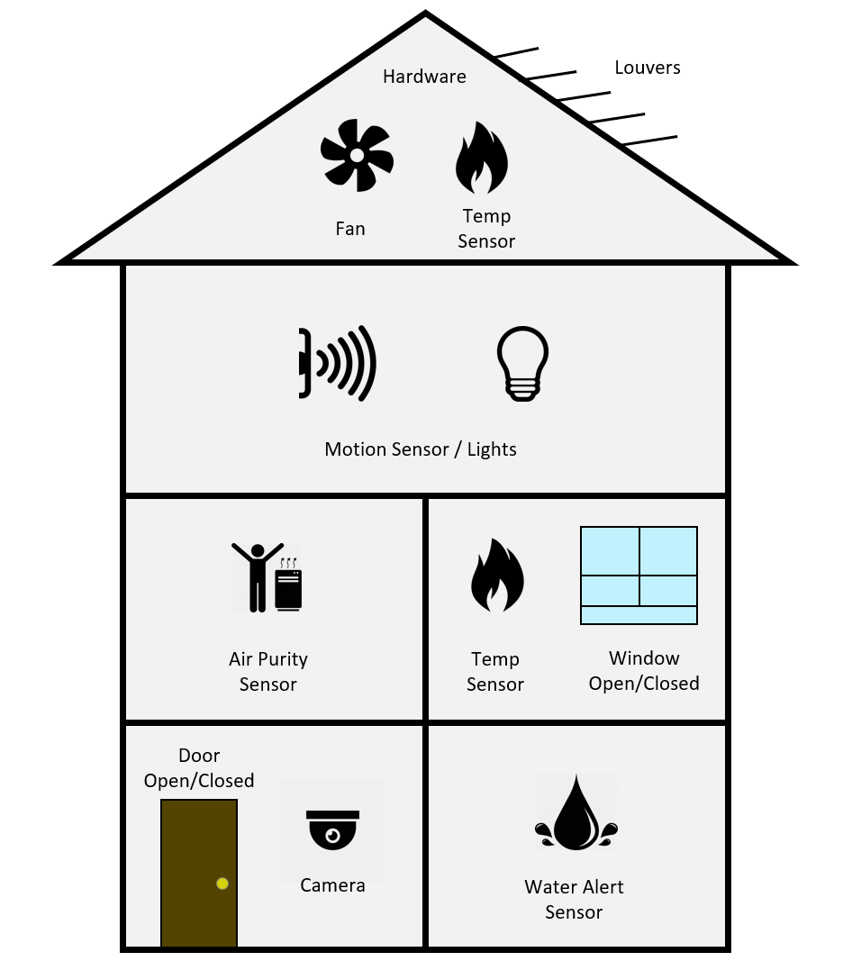
Physical Model Diagram
Notes:
Ben

Slide 4
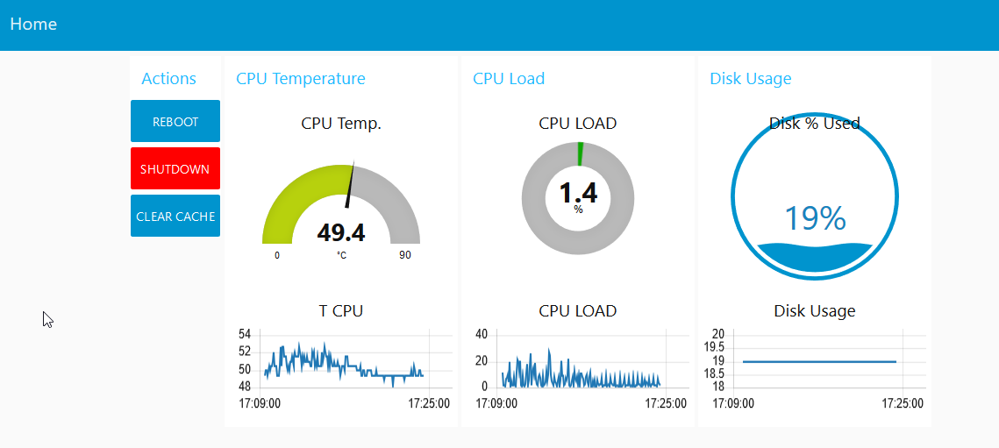
Demo

Slide 5
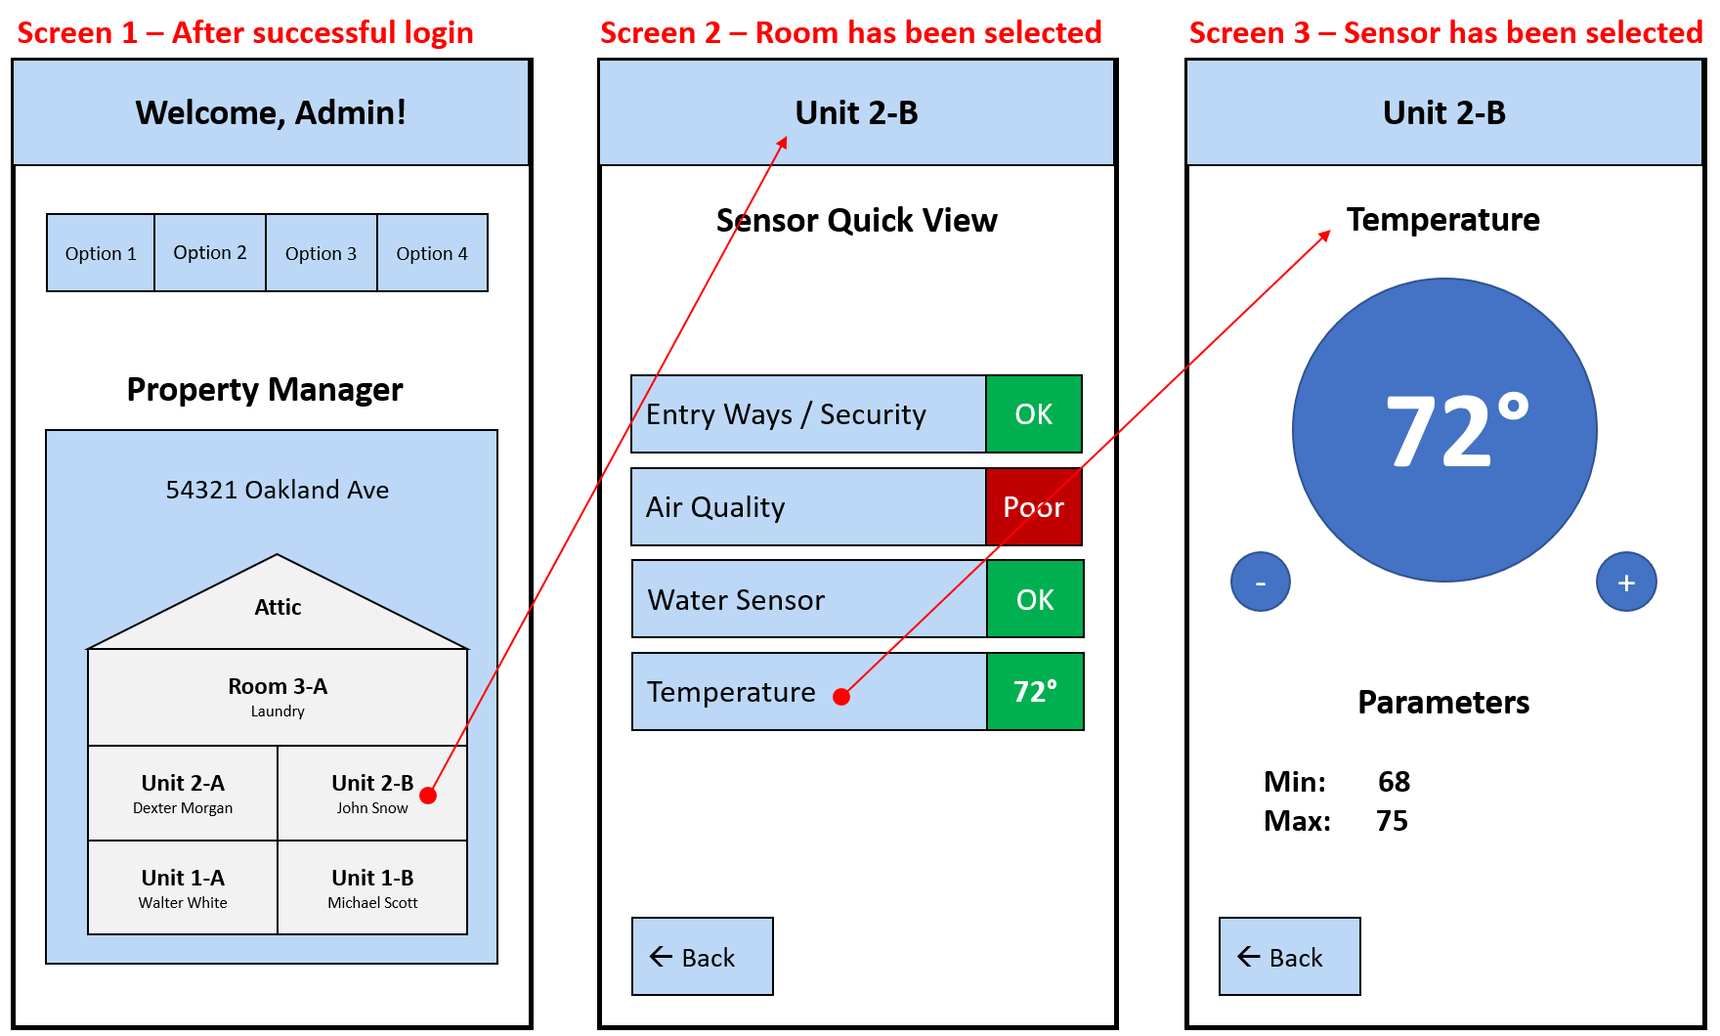
Mobile Application Interface
Notes:
Jeff and Jheryl

Slide 6
Goals for Sprint 3
The focus for the next sprint revolves around system integration including the following…
Reading the data from the sensors via the web and mobile application
Saving the sensor data within the MySQL database
Retrieving the sensor data from the MySQL database
Initial sensor layout and electronics (breadboard)

